Slide 1
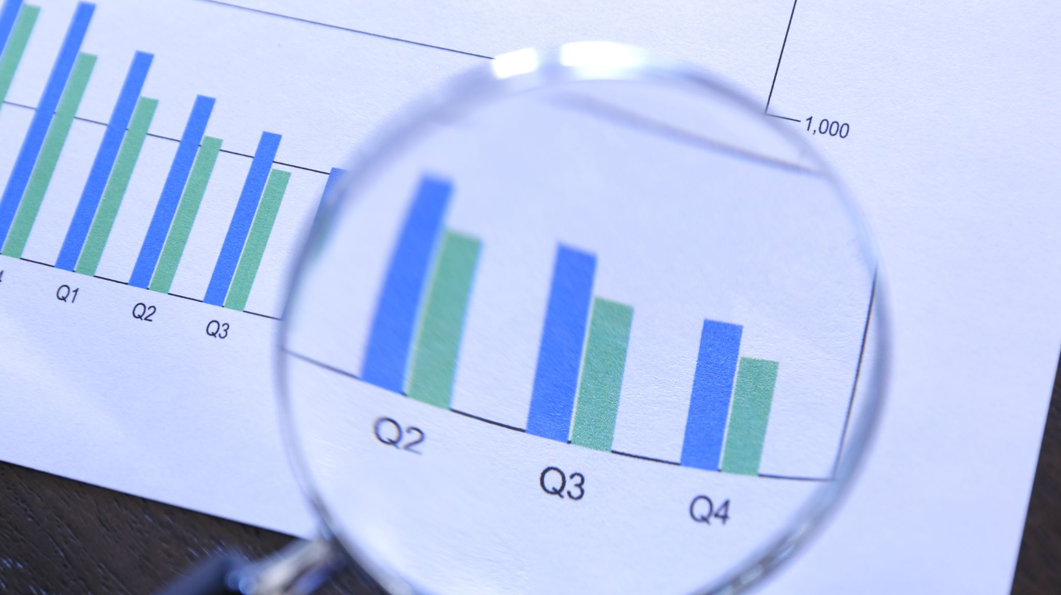
Comprehensive Marketing Report
Data Analysis, Cleaning, Transformation, and Insights

Slide 2
Introduction to Key Marketing Metrics
In marketing, several critical metrics are used to assess the effectiveness of campaigns and strategies. The most important metrics include:
• Customer Acquisition Cost (CAC)
• Conversion Rate
• Return on Investment (ROI)
• Customer Retention Rate
• Churn Rate

Slide 3
Customer Acquisition Cost (CAC)
Customer Acquisition Cost (CAC) is the total cost incurred to acquire a new customer. It includes expenses related to marketing campaigns, advertising, and sales efforts. Lowering CAC while maintaining high conversion rates is a key objective in marketing.

Slide 4
Conversion Rate (%)
Conversion Rate is the percentage of visitors or potential customers who take a desired action, such as making a purchase or signing up for a service. It is calculated as: Conversion Rate = (Conversions / Total Visitors) * 100.

Slide 5
Return on Investment (ROI %)
Return on Investment (ROI) measures the profitability of marketing efforts. It is the percentage of profit gained relative to the amount invested. ROI is calculated as: ROI = (Net Profit / Marketing Costs) * 100. A higher ROI indicates more efficient marketing.

Slide 6
Customer Retention Rate (CRR)
Customer Retention Rate (CRR) is the percentage of customers a business retains over a specific period. A higher retention rate indicates greater customer satisfaction and loyalty. CRR is critical to maintaining long-term revenue streams.

Slide 7
Churn Rate (%)
Churn Rate is the percentage of customers who stop doing business with a company over a given period. It is the inverse of the retention rate. A high churn rate can indicate problems with customer satisfaction or product quality.

Slide 8

Data Transformation & Cleaning
Data transformation and cleaning are essential steps in preparing raw data for analysis. Cleaning removes errors, blanks, and inconsistencies, while transformation reshapes the data into a usable format.

Slide 9

Step 1: Detect Data Type
In this step, we determine the appropriate data types for each column, such as numerical, text, or date. Accurate data typing is crucial for proper analysis.

Slide 10
Step 2: Remove Blank/Empty Rows
Blank or empty rows are removed to ensure that the dataset is clean and devoid of unnecessary gaps, which can distort analysis.

Slide 11

Step 3: Remove Duplicates
Duplicate entries in the dataset can lead to inaccurate results. We remove all duplicate rows to ensure data integrity.

Slide 12

Step 4: Remove Column 'Notes'
The 'Notes' column contains non-essential information that is not required for analysis, so it has been removed to streamline the dataset.

Slide 13
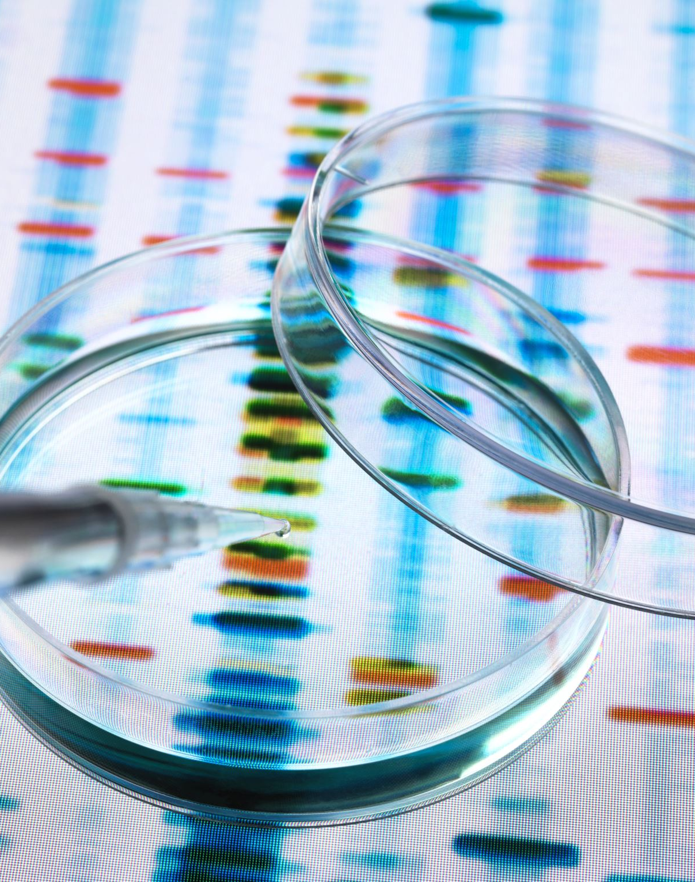
Step 5: Filter Out Errors and Nulls
Errors and null values in the dataset can skew analysis. We filter out all rows with errors or nulls to ensure accuracy.

Slide 14
Step 6: First Row as Column Headers
In this step, we set the first row of the dataset as the column headers, ensuring that each column is clearly labeled for analysis.

Slide 15

Step 7: Append 5 Queries with the Same Structure
To consolidate multiple queries with the same structure, we applied an append operation to merge them into one unified dataset.

Slide 16
Dataset Before and After Cleaning
Before Cleaning & Transformation:
• 100,000 Rows
• 9 Columns
After Cleaning & Transformation:
• 73,257 Rows
• 8 Columns

Slide 17
Key Metrics from the Cleaned Data
The cleaned dataset was used to calculate key marketing metrics, including:
• Customer Acquisition Cost (CAC)
• Conversion Rate
• Return on Investment (ROI)
• Customer Retention Rate
• Churn Rate

Slide 18
Detailed Analysis of Customer Acquisition Cost (CAC)
An in-depth analysis of CAC reveals how marketing efforts have impacted the cost of acquiring new customers over time. Efforts to reduce CAC while increasing customer acquisition were analyzed through various campaigns.

Slide 19
Detailed Analysis of Conversion Rate
Conversion rates from the cleaned data were analyzed to determine which campaigns performed best, identifying key factors that improved conversions, such as offers, timing, and targeting.

Slide 20

Conclusion & Next Steps
This presentation highlighted key marketing metrics, explained the data cleaning and transformation process, and provided detailed insights. Moving forward, the focus will be on improving metrics like CAC, ROI, and retention rates to achieve even better results.

